Slide 1
Flocking part 1
Simulating groups with Steering Behaviours
Programming – AI for Games
Last modified 09/02/16 by Sam Cartwright

Slide 2
Contents
Steering Behaviour Recap
Groups and Boids
Flocking Behaviours
Separation
Alignment
Cohesion
Modified Flocking

Slide 3
Steering Behaviour Recap
Steering Behaviour are a way to add locomotion of autonomous agents
They calculate a force to apply to an agent’s velocity to steer them in a certain direction
Each of the previously discussed steering behaviours focused on individual agents acting alone
Steering behaviours can be extended to add natural-looking group motion to agents

Slide 4
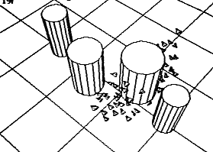
Groups and Boids
Group steering behaviours require an agent to know about other agents around it
Craig Reynolds created a program for simulating bird-like and fish-like flocks and schools, using steering behaviours, in 1986
He called the agents in this technique “boids”, meaning “bird-like objects”
The technique was called “Flocking”

Slide 5
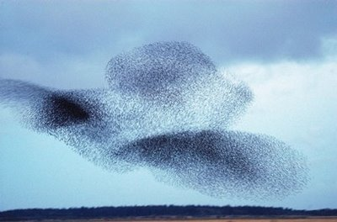
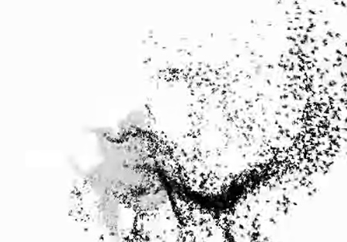
Flocking Behaviours
Boids make use of 3 Steering Behaviours
Separation
Alignment
Cohesion
Together these behaviours create very believable and realistic group motion for many things
Flocks of birds, schools of fish, swarms of insects
Even crowds of people

Slide 6
Boid Neighbourhood
First our boids need a local neighbourhood of other boids near it to create a “flock”
Typically a neighbourhood radius around the boid is used
We could sample against all other boids in the scene, or use spatial partitioning to speed up the search
The boids within this neighbourhood are used in the 3 steering behaviours for flocking

Slide 7
Separation
Separation calculates a repulsion force away from all neighbouring boids and sums the forces together
A repulsion value is used to weight the forces, controlling the spacing
Used to keep a flock spaced apart
By itself this would cause all boids to move as far away from each other as possible

Slide 8
Alignment
Alignment is used to steer the flock in the same direction
The average velocity of all neighbouring boids is calculated as a “desired” velocity
The alignment force is then the difference between the desired and the boid’s current velocity

Slide 9
Cohesion
Cohesion is what makes the flock stay together
Acts against separation
The average position of neighbouring boids is calculated
The boid then simply Seeks towards this target

Slide 10

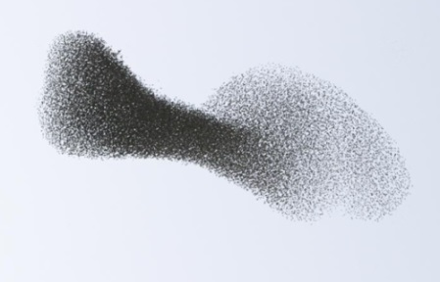
Combining the Behaviours
Combing the force from all three behaviours gives us the flocking behaviour
We can use Weighted Truncated Running Sum with Priority to combine the behaviours, or simply sum the forces to act as a single force
The result gives us interesting flocking and swarming behaviours

Slide 11
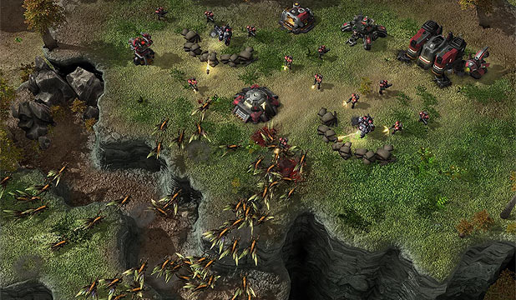
Modified Flocking
Flocking is typically combined with other steering behaviours
Obstacle avoidance means the flock can move around walls and obstacles while still maintaining the flock
Wandering adds an extra bit of randomised motion to the flock, easily representing boids leaving and joining other flocks
A “Leader” can be added to the flock, whose values are weighted higher than others
For example, its alignment velocity could be increased so that other boids follow it

Slide 12
Summary
Flocking is an extremely interesting and dynamic set of behaviours that can easily represent naturally occurring motion within flocks, swarms and schools
Useful in games, film and simulation
Easily combines with other steering behaviours

Slide 13
References
Ian Millington, 2009. Artificial Intelligence for Games. 2 Edition. CRC Press.

